Slide 1
Data Analysis of Cat and Dog Breeds
PRESENTATION BY SIDDHI TANAWADE

Slide 2
Introduction
Objective and Purpose
Identifying key insights on sales, temperament, and breed characteristics.
Finding top selling and least selling breeds for both cats and dogs.
To present insights using charts, and summary statistics for better decision making.

Slide 3
Overview of the Dataset
The data Contains data on various cat and dog breeds, including their popularity and market trends.
It Includes breed-wise quantity sold, average price, average sales.
It also provides data on breeds characteristics i.e. (temperament, weight, features etc.)

Slide 4
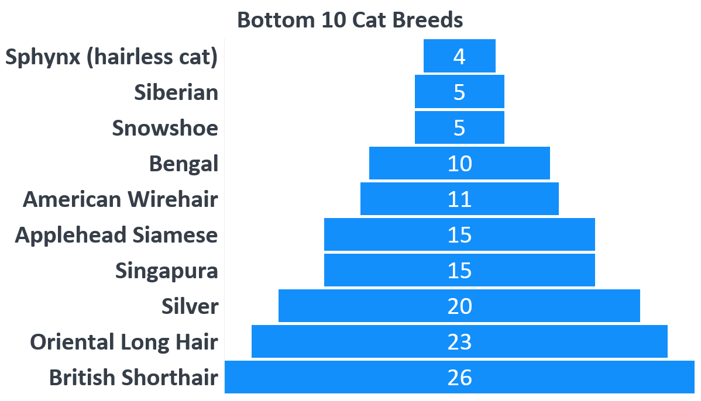
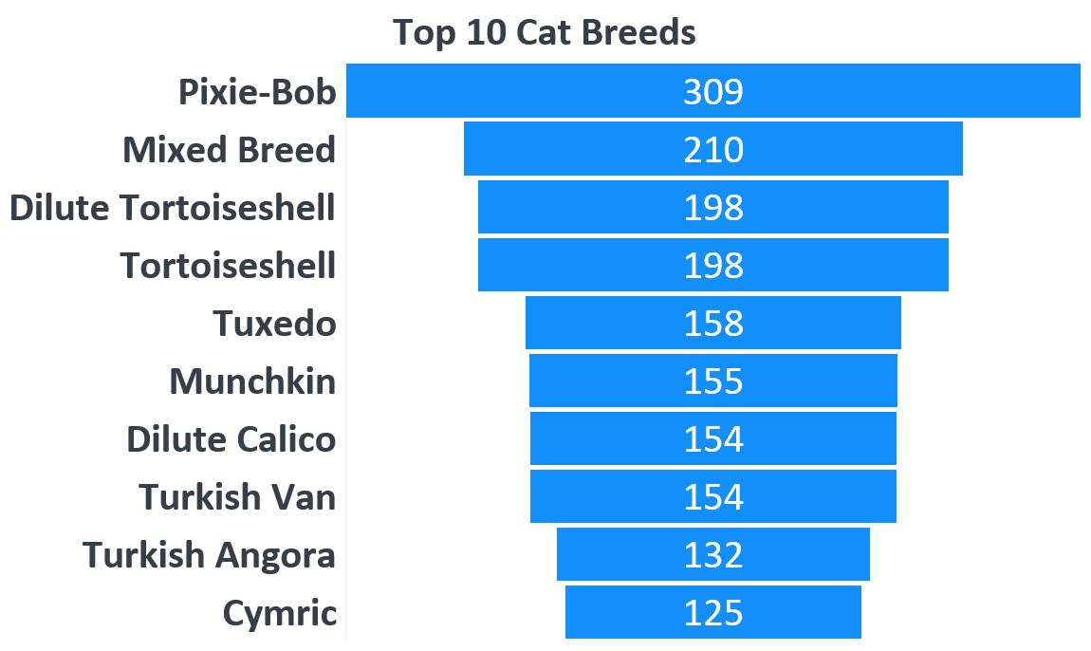
Sales Analysis of Cat Breed
Key Insights :
Pixie bob is one of the highest selling cat breed by 309 with average sale of 4.611940299
Sphynx breed has lowest 4 count with average sale of 0.059701493 .

Slide 5
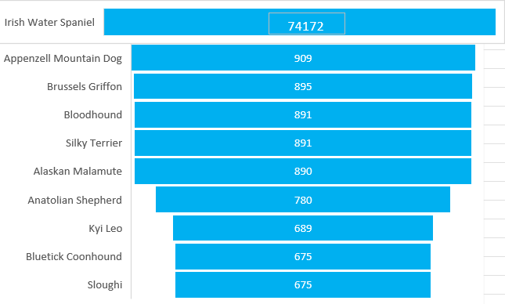
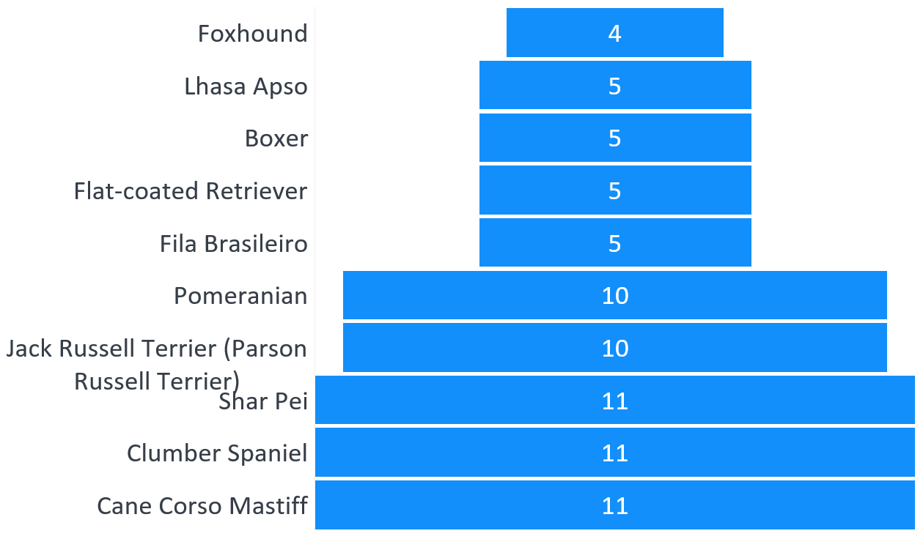
Sales Analysis of Dog Breed
Key Insights :
Irish water spaniel is been the record breaker by 74172 dog breed sale with average sales of 296.688
Foxhound has 4 dog breed sale with average sale of 0.016 .

Slide 6
Affectionate Temperament Analysis

Slide 7
Additional Insights for Cat Breeds
As per the overall analysis for cat breeds:
A significant percentage of cat breeds are classified as lap cats, indicating a preference for companionship and indoor living.
The lap cat trait has a strong correlation with higher popularity and sales.
Cats with long hair tend to have a higher average weight compared to short-haired breeds.

Slide 8
Additional Insights for Dog Breeds
As per the overall analysis for cat breeds
:
The Working group has the highest count of popular dog breeds (49).
Working dogs have the highest average weight 43.92 kg.
The most common groups include Herding (16%), Companion (14%), Guardian (14%), and Gun Dogs (14%).
Most of the Dog breeds does not have affectionate temperament.

Slide 9
PRESENTATION BY SIDDHI TANAWADE
THANK YOU

